Slide 1

SMART GRADER
SPRING 2022 CAPSTONE PROJECT | DELIVERABLE-7
GUIDED BY-PROF.HENRY WONG

Slide 2

Team Members
AKANKSHYA BISWAL
EMI HARRY
GIO ABOU JAOUDE
JONATHAN ANGAMARCA
JOSEPH DOUGAL
JOSE SALCEDO
RITHVIK SUBRAMANYA
TJ RABBANI
JONATHAN ANGAMARCA

Slide 3

Agenda
Project Description
Sprint 6 Recap
Sprint 7
Sprint-7 Test Cases
Burndown Chart
Project Timeline
Retrospective
Conclusion
Project Demo
JONATHAN ANGAMARCA
Notes:
Project Description and Project Components
Technologies used in the project
Market Analysis
User personas
Milestone timeline
Retrospective: things that worked

Slide 4

PROJECT DESCRIPTION
JONATHAN ANGAMARCA

Slide 5
Login to the application.
Teachers/educators can generate & post questions for assignments .
Students can solve the assignments posted by their teachers and submit the assignments.
Smart Grader would grade the assignments.
Grading system is available for both Math and English based assignment questions.
JONATHAN ANGAMARCA

Slide 6

SPRINT 6 RECAP
TJ RABBANI

Slide 7
Committed Task and Stories
​ Task/Story​ | Key​ | Description | Story/Task Points​ | ​Priority​/Status
Story​ | Key-11 | As an educator, I want to navigate to the English tab under the subject's menu. | 13 | Highest
Task​ | Key-8 | Built the teacher-English html | 5 | High
Story​​ | Key-26 | As an educator, I want to insert English questions for the assignment. | 8 | High
Task | Key-15 | Setup database tables for teacher and student | 5 | High
Task | Key-16 | Built backend functionality to insert questions | 5 | High
Task​ | Key-17 | Built backend functionality to update questions | 5 | High
Task​ | Key-18 | Built backend functionality to delete questions | 3 | High
Task​ | Key-19 | View text that will be used in ML process to check students answers to teacher's questions | ​3 | High
TJ RABBANI

Slide 8
​​ Task/Story​​ | Key​​ | Description | Story/Task Points​​ | ​​Priority​​/Status
Story | Key-27 | As an educator, I want to delete the English questions for the assignment. | ​8 | High​
Story | Key-28 | As an educator, I want to see the English text for which I want to create questions for the assignment. | ​8 | High​
Task | Key-23 | Deployed ML code for testing and integration | 5 | High
Task | Key-31 | Adding student English routes for student account. | 5 | In Progress( Sprint 7)
Task | Key-32 | Built student-English html. | 3 | In Progress( Sprint 7)
Task | Key-33 | Built backend functionality to insert answer for student account. | 3 | In Progress( Sprint 7)
Task | Key-34 | Built backend functionality to update answer for student account. | 3 | In Progress( Sprint 7)
TJ RABBANI

Slide 9
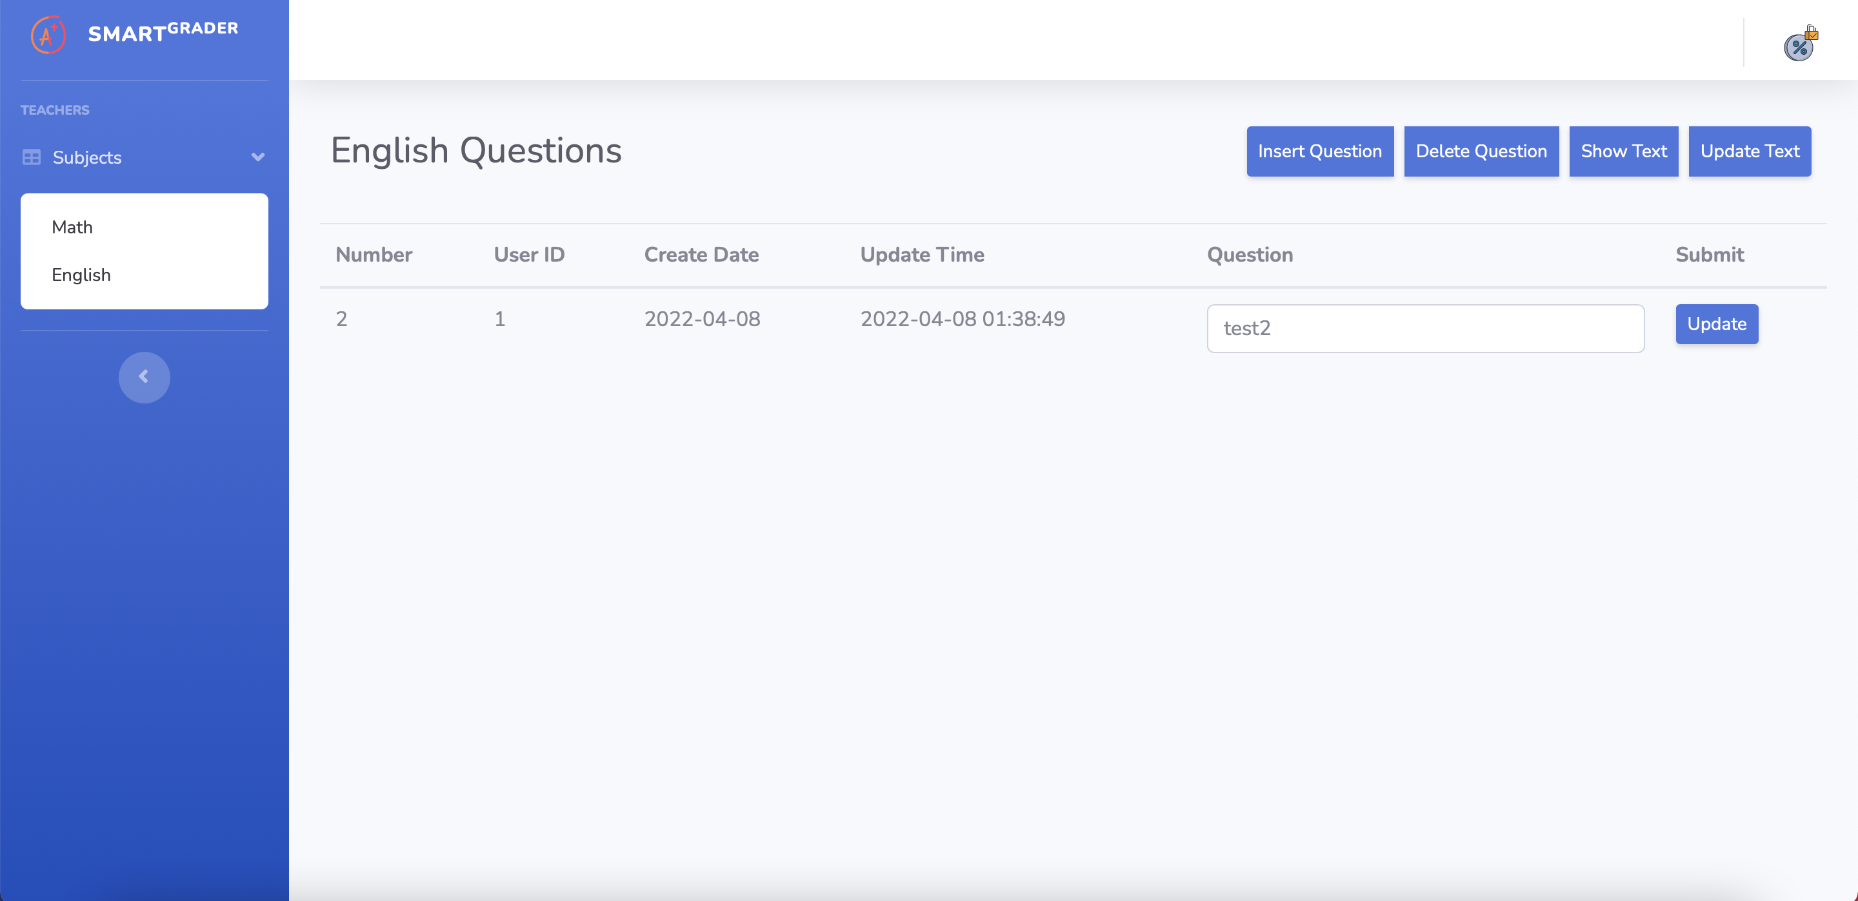
New Updates in SMART GRADER: Input Page
TJ RABBANI

Slide 10

SPRINT 7
JOSE SALCEDO

Slide 11
Completed Task/Stories for Sprint-7
​​ Task/Story​​ | Key​​ | Description | Story/Task Points​​ | ​​ Priority​​/Status
Story | Key-38 | As a Student, I want to navigate to the English section in the Menu Tab. | 8 | Highest
Story | Key-39 | As a Student, I want to insert/update answer in the English section. | 5 | High
Task | Key-31 | Adding student English routes for student account. | 5 | High
Task | Key-32 | Built student-English html. | 3 | High
Task | Key-33 | Built backend functionality to insert answer for student account. | 3 | High
Task | Key-34 | Built backend functionality to update answer for student account. | 3 | High
JOSE SALCEDO

Slide 12
Tasks To Be Completed in Sprint-8
​​ Task/Story​​ | Key​​ | Description | Story/Task Points​​ | ​​ Priority​​/Status
Task | Key-42 | To display Math and English Test Result | 8 | Highest
Task | Key-43 | Setting up an NLP pipeline to compare and grade users answers with ML generated results. | 5 | High
Story | Key-40 | As an educator I should be able to see the grades of the student for the assignment I have provides for Math. | 3 | High
Story | Key-41 | As an educator I should be able to see the grades of the student for the assignment I have provides for English. | 3 | High
JOSE SALCEDO

Slide 13

SPRINT-7 TEST CASES
RITHVIK SUBRAMANYA

Slide 14
TEST CASES ​ FOR​​ | KEY​ | TEST CASES​​ | TEST DATA​ | EXPECTED RESULTS​​ | ACTUAL RESULT​ | Pass/Fail​​
Input Page (Test ID-38) | Key-38 | Subject button | Users in the student account should be able to navigate to the English tab in the subject's menu. | Every user in the student profile should be able to access the English subject tab. | Students can now navigate to the English tab in the subject's menu. | Pass​​
​Input page (Test ID-39) | Key-39 | Answer Field | Users in the student account should be able to insert the English answers for the assignment. | Every user in the student profile should be able to insert answer to the English questions. | Students can now insert answer to the English questions in the answer field. | Pass​​

Slide 15
TEST CASES ​ FOR​​ | KEY​ | TEST CASES​​ | TEST DATA​ | EXPECTED RESULTS​​ | ACTUAL RESULT​ | Pass/Fail​​
Input Page (Test ID-40) | Key-39 | Update button | Users in the student account should be able to update the English answer for the assignment. | Every user in the student profile should be able to update the English answer. | Students can now update the wrong answers that they have inserted by using the "Update" button. | Pass​​

Slide 16
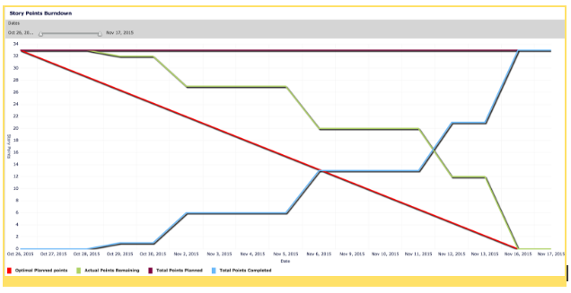
BURNDOWN CHART
EMI HARRY

Slide 17
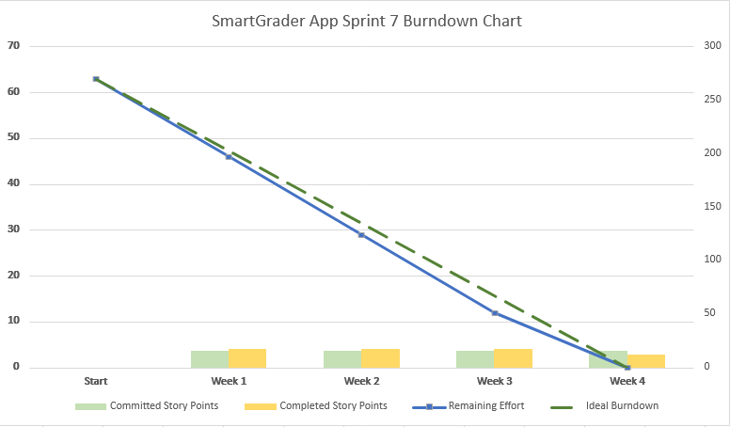
EMI HARRY

Slide 18
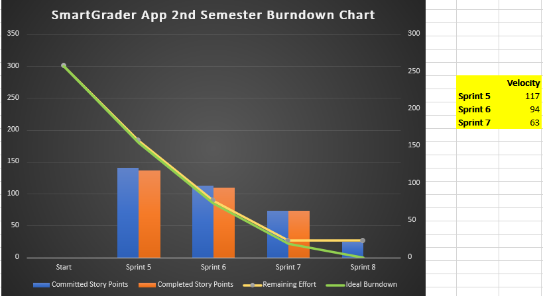
EMI HARRY

Slide 19

MILESTONE TIMELINES
EMI HARRY

Slide 20
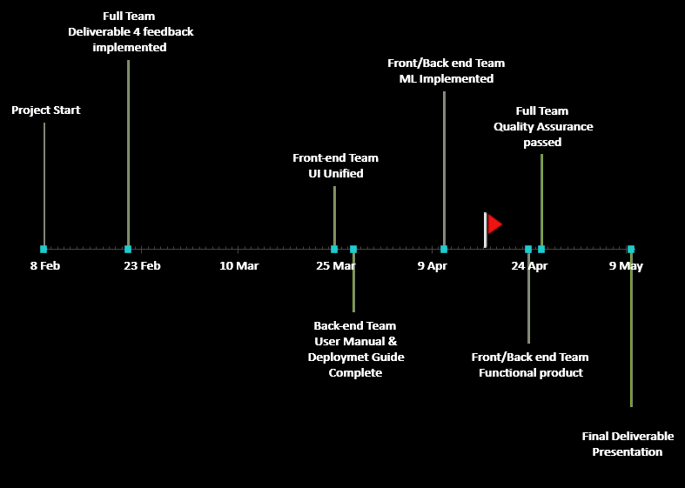

Sprint-7
Sprint-6
Sprint-8
Sprint-5

Slide 21

SPRINT 7 DELIVERABLE
GIO ABOU JAOUDE

Slide 22
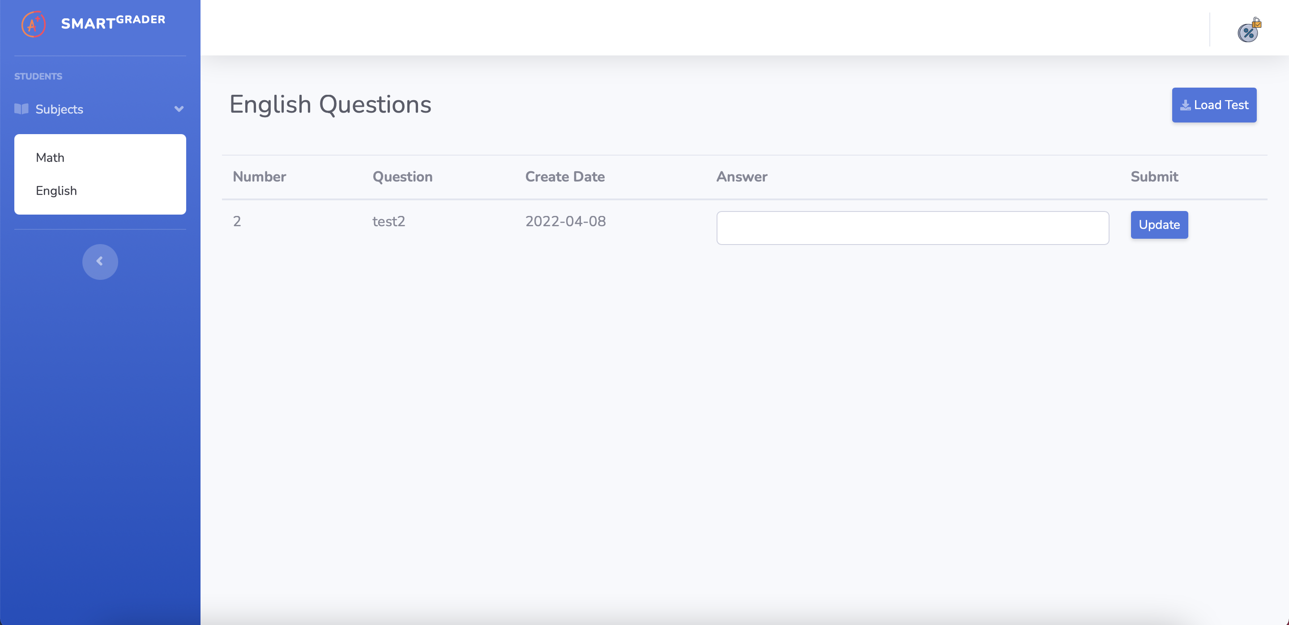
Changes Made on Smart Grader
GIO ABOU JAOUDE

Slide 23

Retrospective
AKANKSHYA BISWAL

Slide 24
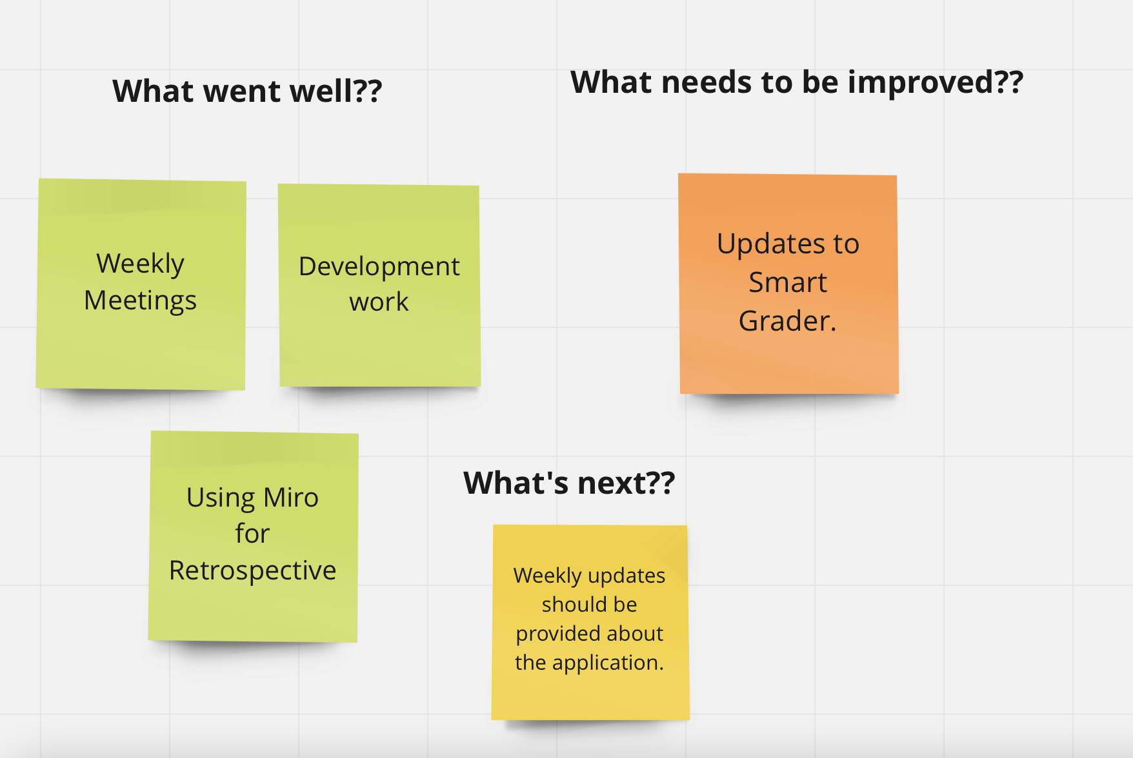
AKANKSHYA BISWAL

Slide 25

Conclusion
FOR MORE DETAILS ON SMART GRADER VISIT OUR GITHUB REPOSITORY:
https://github.com/josephdougal/CS691/projects/1
AKANKSHYA BISWAL

Slide 26
PROJECT DEMO
JOSEPH DOUGAL

